Slide 1


CAPSTONE PROJECT
David Nene
Bachelor’s Degree in Economics and Mathematics

Slide 2
Table of Contents
01
CRISP - DM
05
Track Segmentation
02
Spotify Technology
06
Summary and Recommendation
03
07
Solution Implementation
Data Overview
08
Data analysis Notebook
04
Random Forest Model

Slide 3
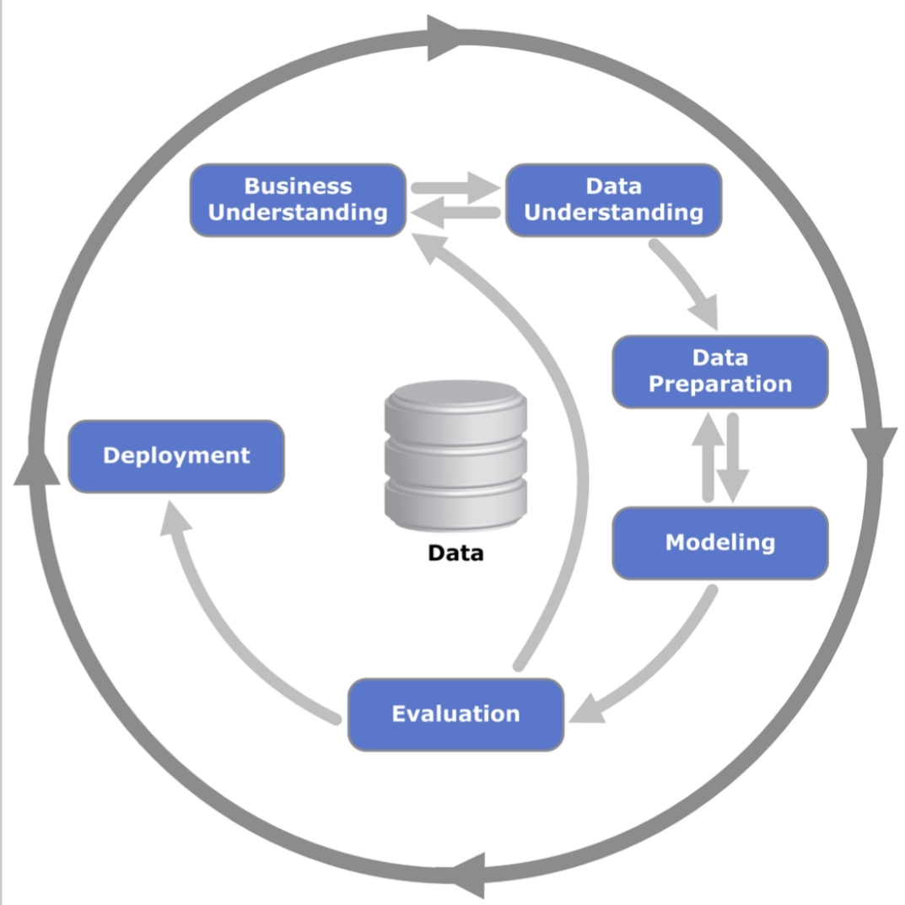
CRISP-DM
Cross industry Standard Process for Data Mining

Slide 4
SPOTIFY TECHNOLOGY
BACKGROUND INFORMATION
Spotify Technology is a Swedish music streaming and media services provider that provides an audio streaming platform, the "Spotify" platform, that offers DRM-restricted music and podcasts from record labels and media companies.
The Spotify platform provides access to over 50 million tracks. Users can browse by parameters such as artist, album, or genre, and can create, edit, and share playlists.
The service is available in most of Europe and the Americas, Australia, New Zealand, and parts of Africa and Asia, and on most modern devices, including Windows, macOS, and Linux computers, and iOS, and Android smartphones and tablets.

Slide 5
SPOTIFY TECHNOLOGY
PROBLEM STATEMENTS
Conduct an EDA on the dataset and come up with some data visualisations.
Building a machine learning model that predicts track popularity since this would increase revenue and presenting the results to the senior management of Spotify.
Spotify’s senior management is interested in segmenting tracks on their platform. This will be helpful in identifying new genres of music. You are tasked with building a model that segments the tracks and presenting the results to the senior management of Spotify.

Slide 6
SPOTIFY TECHNOLOGY
PROPOSED SOLUTION
Machine learning model deployment following the CRISP-DM framework

Slide 7
METHODOLOGY
01
Data collection
02
Data preparation
Collecting data on available tracks from the company’s database.
This involves data cleaning, Exploratory Data Analysis
Deployment
04
03
Data modeling and Evaluation
To initialize a platform whereby the model will perform its task.
Selecting the best model to use and performing evaluation to ensure high model efficiency

Slide 8
SPOTIFY TECHNOLOGY
Dataset overview
The dataset contains 32,833 rows and 23 columns
Track_id
Track_name
Track_artist
Track_album_id
Track_album_name
Track_album_release_date
loudness
Playlist_name
Playlist_id
Playback_id
Playlist_genre
Danceability
Energy
Key
Duration_ms
Mode
Speechiness
Acousticness
Instrumentalness
Liveness
Valence
Tempo
Track_popularity

Slide 9
SPOTIFY TECHNOLOGY
Data Cleaning
Feature | No. of Missing Data
Track_name | 5
Track_artist | 5
Track_album name | 5
Total | 15
We dropped the missing values since they would cause no significant effect to our analysis
No. of rows dropped = 5
New data shape
(32828, 23)
Outliers
The dataset has 42.01% of outliers.
This is a huge number and dropping them will lead to almost half of the data lost hence we will retained them.
Duplicates – There were no duplicates in the data

Slide 10
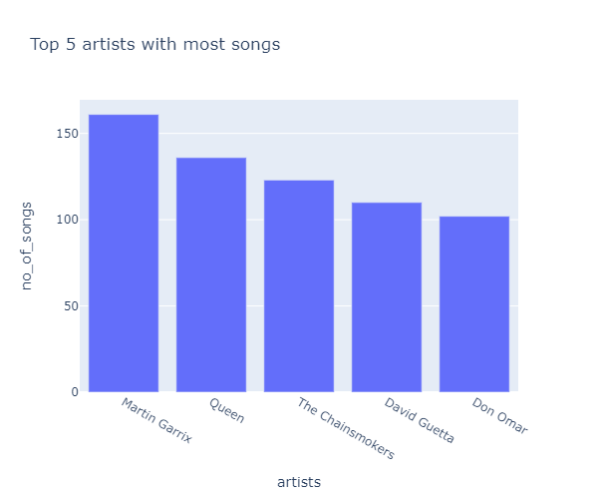
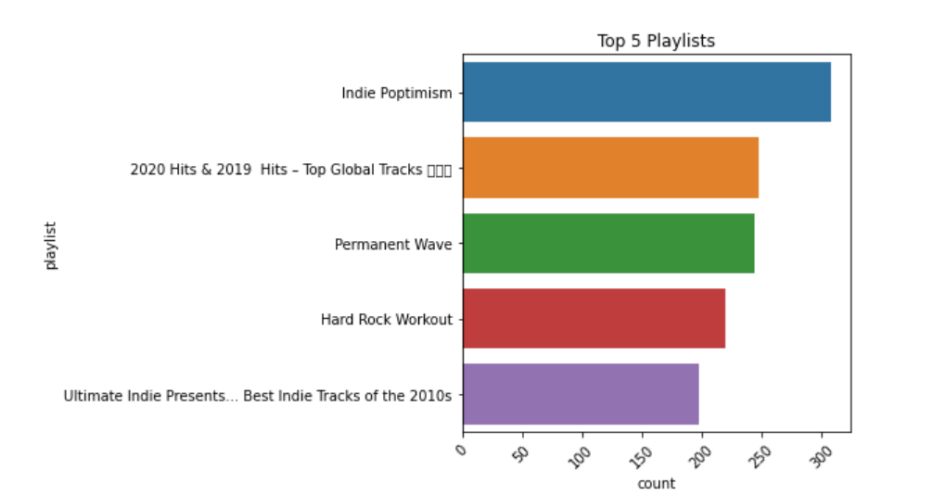
SPOTIFY TECHNOLOGY
univariate analysis
Distribution of numeric variables
Refer to notebook

Slide 11
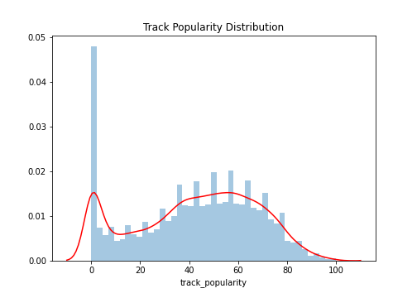
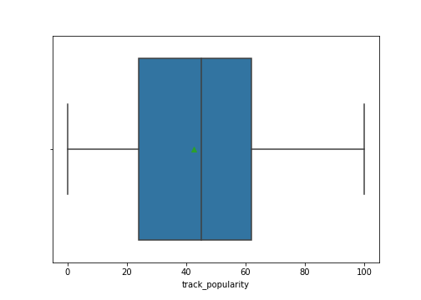
SPOTIFY TECHNOLOGY
Track popularity Distribution

Slide 12
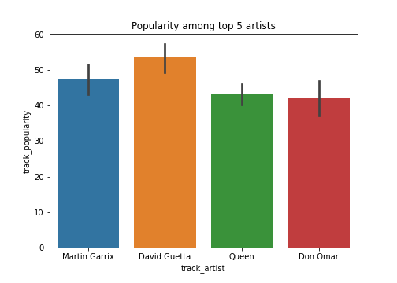
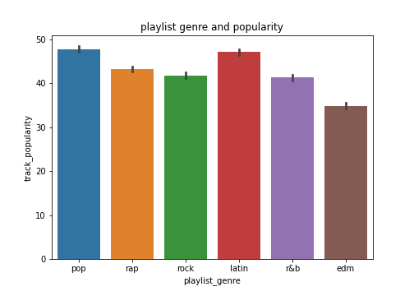
SPOTIFY TECHNOLOGY
Bivariate analysis

Slide 13
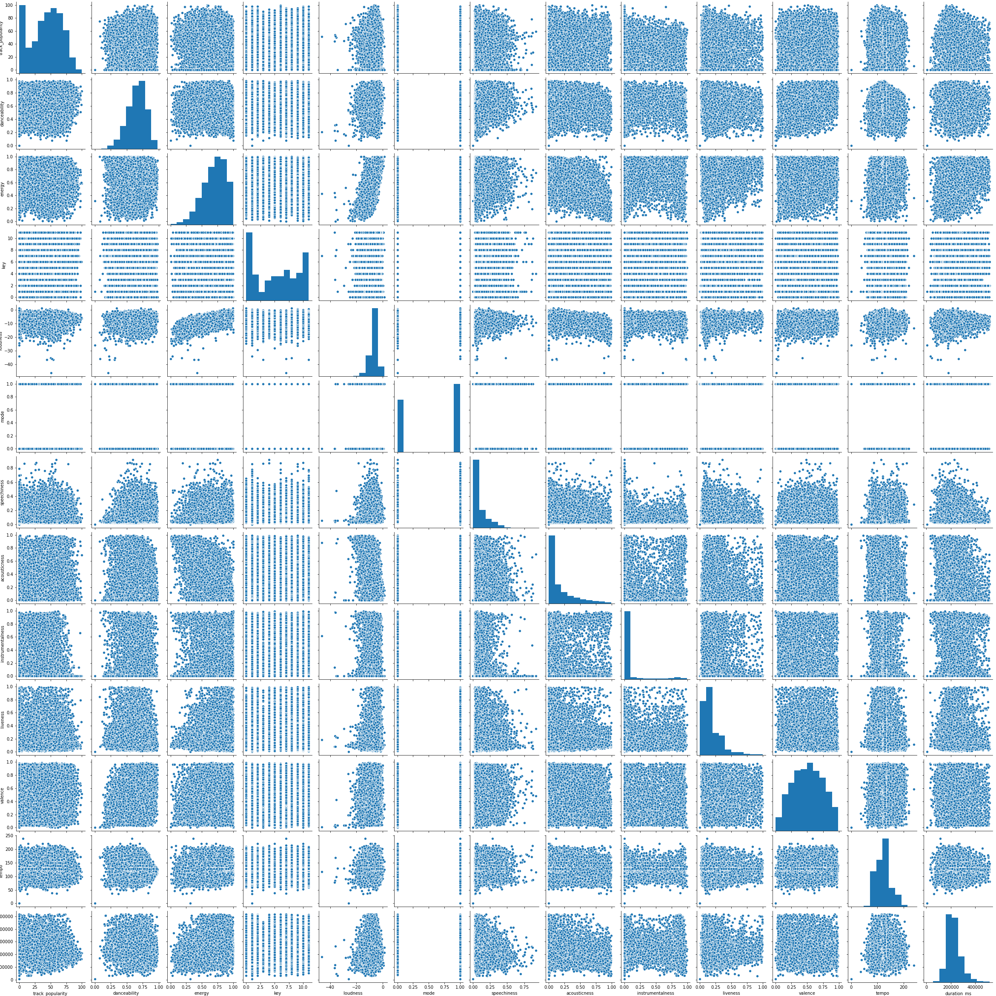
SPOTIFY TECHNOLOGY
Pair Plot
track_popularity
danceability
energy
key
loudness
mode
speechiness
acousticness
instrumentalness
liveness
valence
tempo
duration_ms

Slide 14
SPOTIFY TECHNOLOGY
Predictive Model Selection
The lower the Root Mean Squared Error , the better the model.
Ensemble learning Models
MODEL | RMSE
Bagging estimator regressor | 22.15
Random Forest regressor | 20.99
Ada Boost Regressor | 23.91
Gradient Boost Model Regressor | 23.45
Xgboost regressor | 23.45
Hyperparameter tuning
randomforest_regr2 = RandomForestRegressor(random_state=42, min_samples_split=2, n_estimators=300, . min_samples_leaf=1, n_jobs=7)
MODEL | RMSE
Random Forest Regressor2 | 20.88

Slide 15
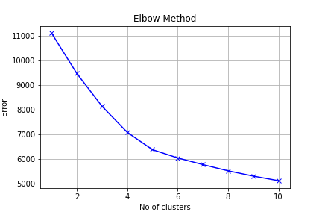
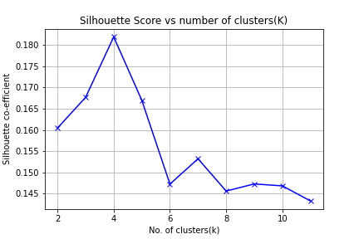
SPOTIFY TECHNOLOGY
Track Segmentation
Model : K-Means algorithm
Optimal number of clusters : 4

Slide 16
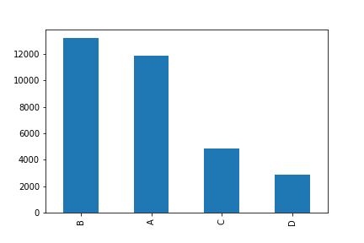
SPOTIFY TECHNOLOGY
Segments overview
Segments | No. of trcks
A | 11,881
B | 13,211
C | 4,879
D | 2,857

Slide 17
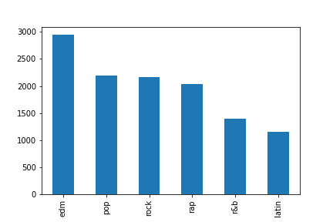
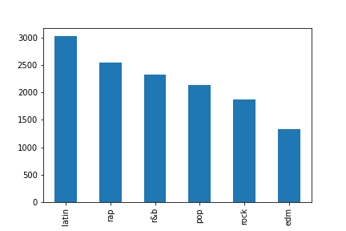
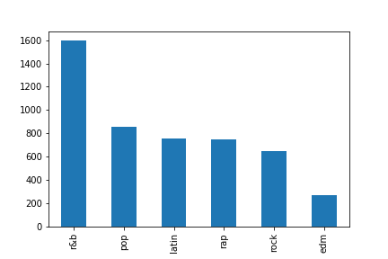
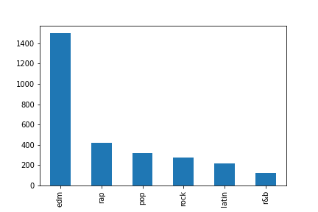
SPOTIFY TECHNOLOGY
Segments overview
Segment A
Segment B
Party Your Body
Senses
William Black
Remix
Segment C
Segment D
Should Have Known Better
My Beat

Slide 18
Summary and recommendations

Slide 19
SPOTIFY TECHNOLOGY
Summary of Findings
Latin and pop are the most popular music genres
Latin dominated popularity in 2019
David Guetta is the most popular artist
Progressive Electrohouse sub-genre had the highest number of tracks
The data set is comprised of normally distributed variables
The dataset has a lot of outliers
Different playlist genres are dominating the clusters
The optimal number of clusters to use for segmentation is 4

Slide 20
SPOTIFY TECHNOLOGY
Recommendations
Tips to increase sales;
The company should focus more on latin and pop music since they have the highest popularity
The best predictive model to use is Random Forest regressor. The model will be able to predict the popularity of incoming tracks.
3. The company should take note of incoming tracks that fall in segment A and B since they have high frequency.
4. The company should try to research on why there are a lot of outliers in the dataset to improve models prediction efficiency

Slide 21
SPOTIFY TECHNOLOGY
Impact of the solution
Data analysis results will assist the management to identify and understand the data more. For example distributions, top rated tracks, genre popularity..
The management will be able to have popularity predictions on incoming tracks early enough thereby making better plans on the track accessibility to people. Hence more revenue
3. The track segmentation will make genre grouping easier hence less time is required.

Slide 22
Solution Implementation
Project Manager
01
Project
02
Data Scientist
03
Software engineer

Slide 23
SPOTIFY TECHNOLOGY
Case Studies
Banking Sector
Banking analysis requires a lot of effort as it contains a high risk of profit and loss. Customer analysis is one of the most used studies adopted in banking sectors. Problems such as loan default chance of a customer or for detecting any fraud transaction, random forest has been a great choice.
Healthcare Sectors
In pharmaceutical industries, random forest has been used to identify the potential of a certain medicine or the composition of chemicals required for medicines. It has also been used in hospitals to identify the diseases suffered by a patient, risk of cancer in a patient, and many other diseases where early analysis and research play a crucial role.

Slide 24
SPOTIFY TECHNOLOGY
Limitations of random forest model
It requires much computational power as well as resources as it builds numerous trees to combine their outputs.
Due to the ensemble of decision trees, it also suffers interpretability and fails to determine the significance of each variable.

Slide 25
SPOTIFY TECHNOLOGY
Data analysis notebook
Link to google colab notebook:
https://colab.research.google.com/drive/1Chc6OTUGs30lDlLoeGjYzsnLy6jOcEJD#scrollTo=GcEd6edO26Mr

Slide 26
THANKS

